Slide 1

BU Fitness App
Alberto Attie
Ramy Attie
Max Karambelas
Kfir Flank
Andres Garcia

Slide 2

Swift Language
We decided to use Swift language since that is Swift is a powerful and intuitive programming language for iOS
Advantages
It’s also easier to read and write, and it requires much less code than other languages.
Can use Classes and create apps in an understandable way
Apps developed with Swift require less time to install and less on-device memory, providing a better app experience for users.

Slide 3
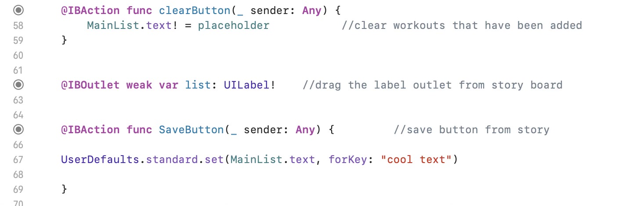
Actions and Outlets In Swift
You declare an outlet in the interface of a class, and you make a connection between the outlet and another object in the nib file or storyboard.
In our program The label is an outlet for the buttoms comands. An outlet functions as a display or cout buttom.
We Create an action connection when you need to send a message from a control to your code.
A control is a user interface object that causes instant actions or visible results when the user manipulates the object.
In our case the functions work as actions since they are performing an action, but does not display anything.
Here the outlet is feeding the lables in our program
The Function here are bringing the user input from the textfields to the labels

Slide 4
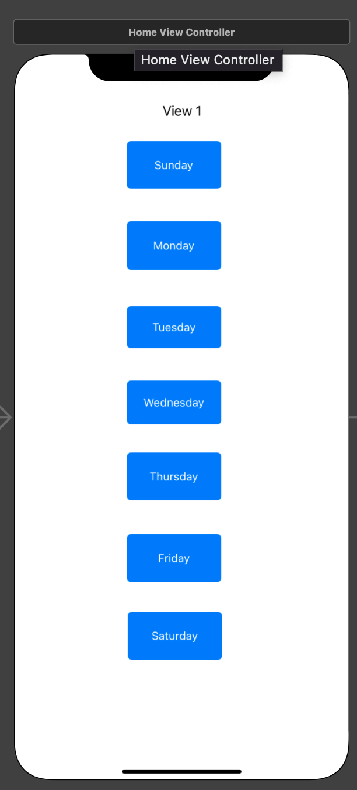
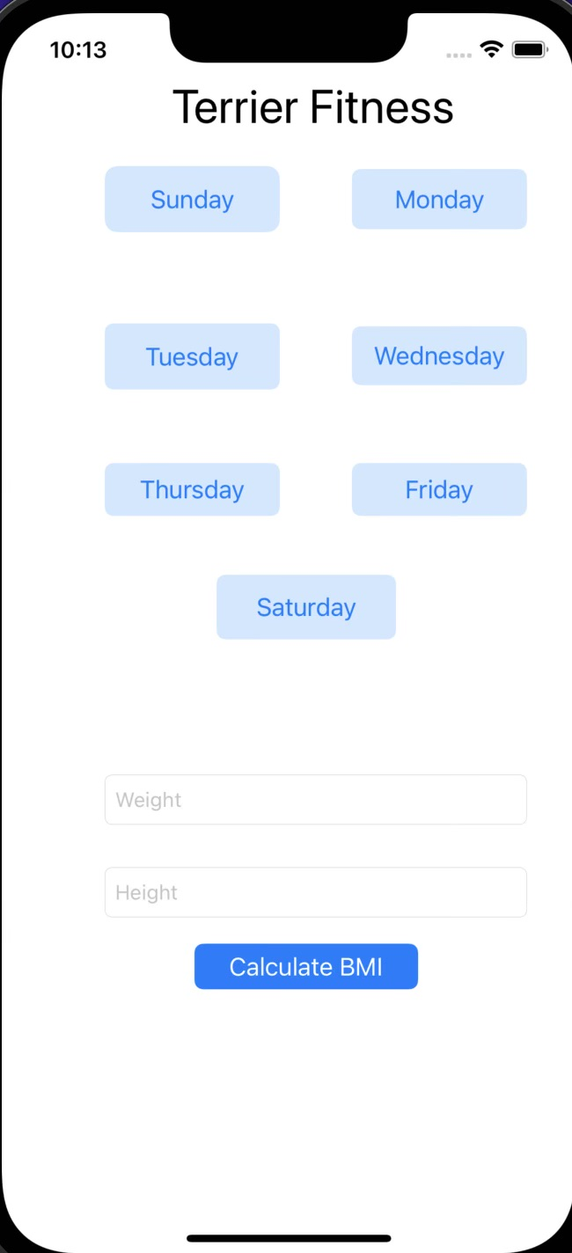
Description of the App
HOME SCREEN
Our FitnessApp consists of making a routine of different exercises for people who want to exercise a specific part of the body.
For example if people want to exercise core, the app will create a routine to exercise core depending on the fitness level of the user( Advance, beginner, or Intermedium). The user defines how many repetition he wants to make
NEW VERSION

Slide 5
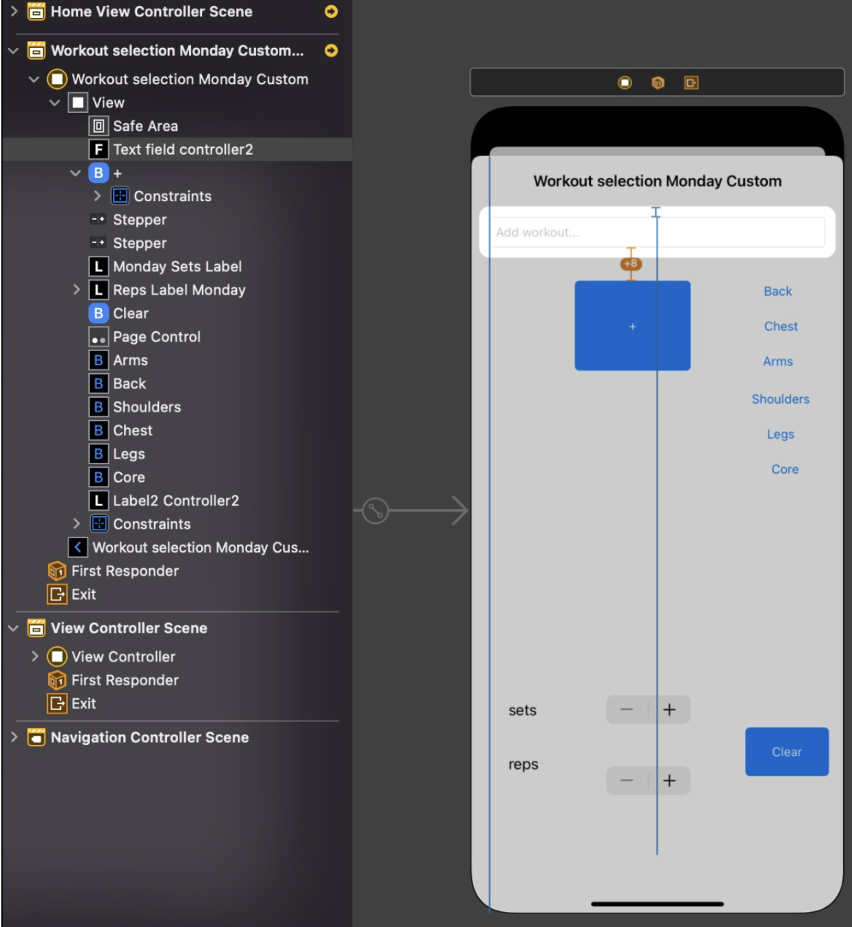
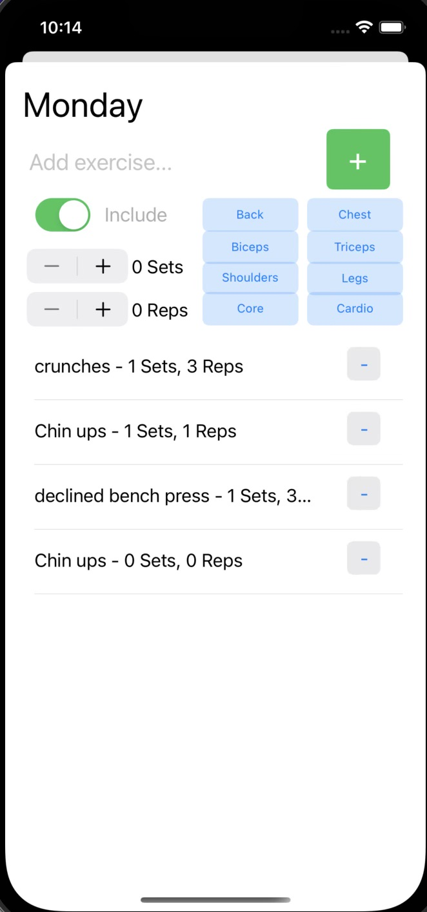
How it works
First the app list all the days of the week in order to plan a workout routine based on the day the user enters.
Here the user can add any custom workout he wants to do and it will add to the routine created by the App depending on the reps and and sets the user wants tom do.
NEW VERSION

Slide 6
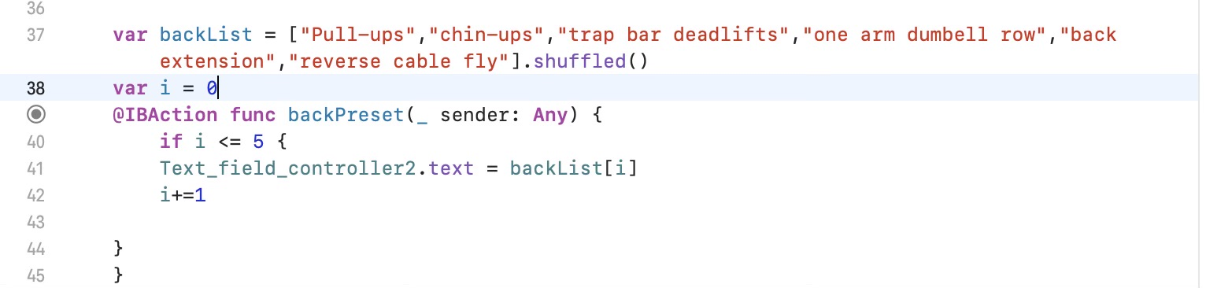
Adding workout button
Computer Creating workouts
MAX AMOUNT OF WORKOUTS CREATED BY COMPUTER
The program creates a list of workouts
The user cannot exceed the amount of workouts created by the computer but he can still add his custom workouts

Slide 7
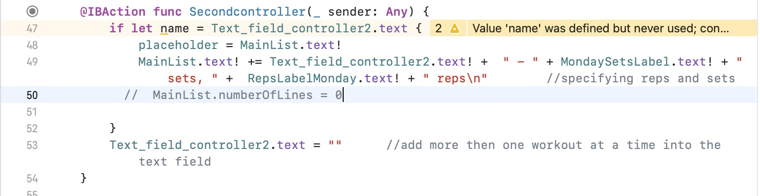
Create Custom Workout
Add it to list
The user can input his custom workout and add it to the list created by the game
The IBAction fuction takes the text in the text field controller(user input) and assigns it to the main list

Slide 8
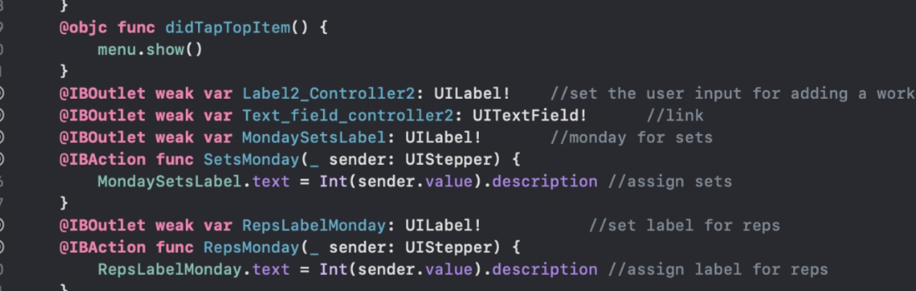
Sets and reps
The User can edit the numbers of sets and reps he wants to do

Slide 9
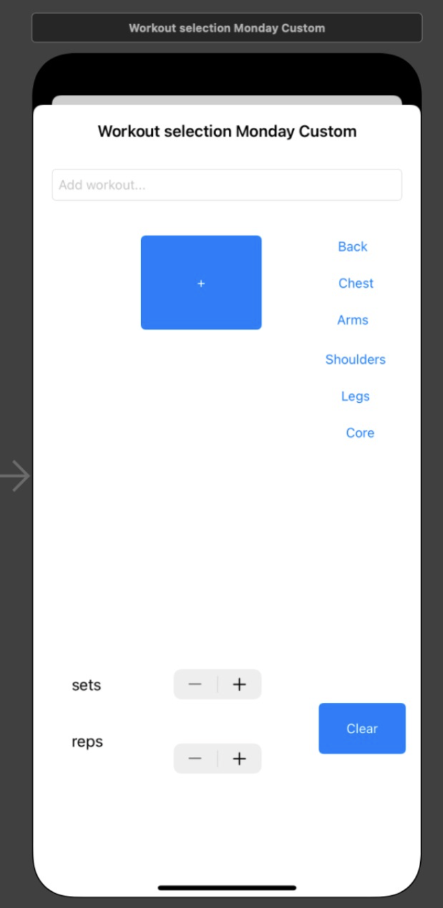
Clear and Save Buttom
The clear buttom (minus sign) deletes the users’s custom workout and the workout created by the computer
The Save buttom saves the workout created by the user and the computer’s after being added to list
NEW VERSION

